Slide 1
HARDWARE HACKATHON
SMART DUSTBIN

Slide 2
PARTICIPANTS- 1.Amit Kumar Thakur 2.Kunal Garg 3.Abhishek Verma 4.Khushpreet Kaur
U.I.E.T

Slide 3
Hardware used
Ultrasonic sensor HC-SR04
Infrared sensor
Node MCU
Moisture sensor FC-28
Servomotor
LEDS
Jumper wires

Slide 4
Software used
Arduino ide

Slide 5
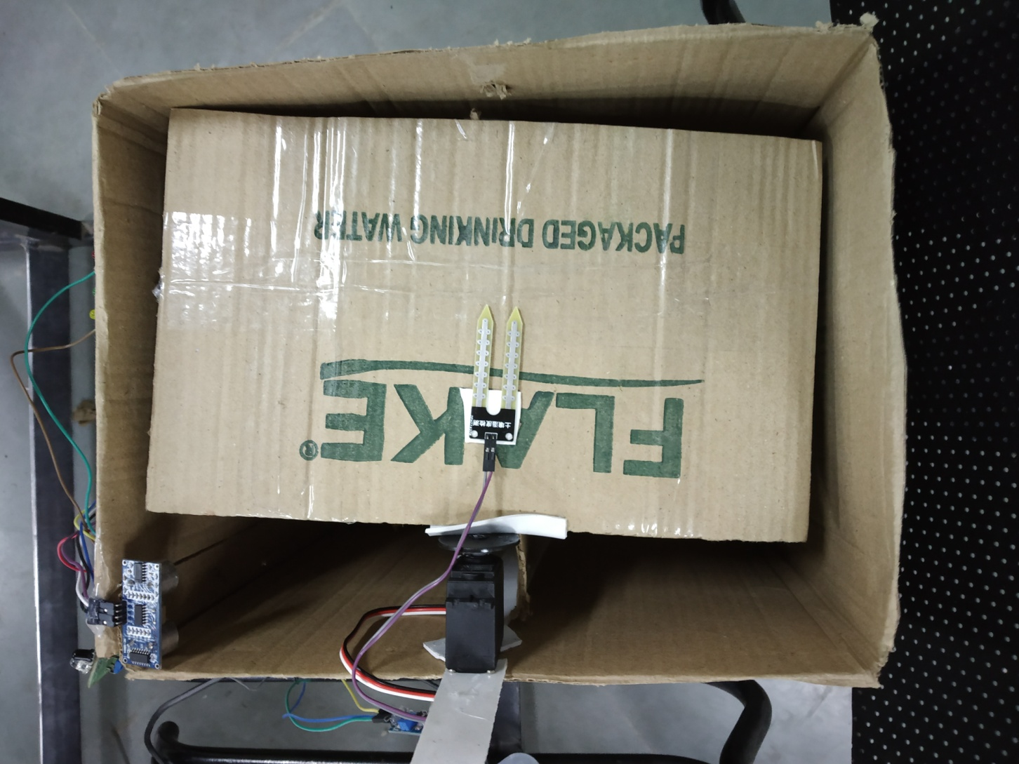
TOP VIEW

Slide 6
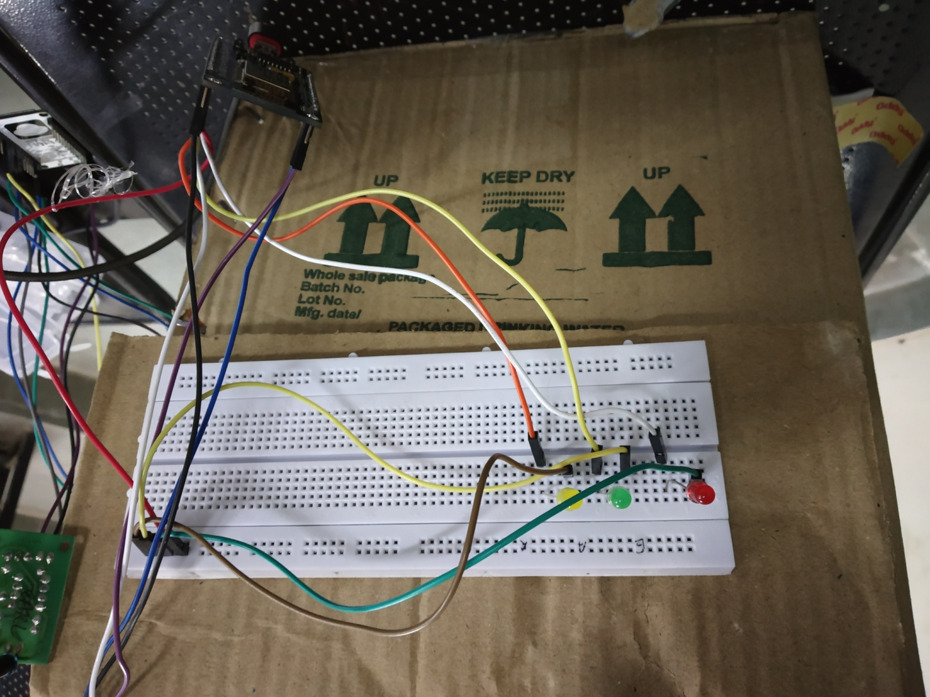
ULTRASONIC SENSOR INDICATOR

Slide 7
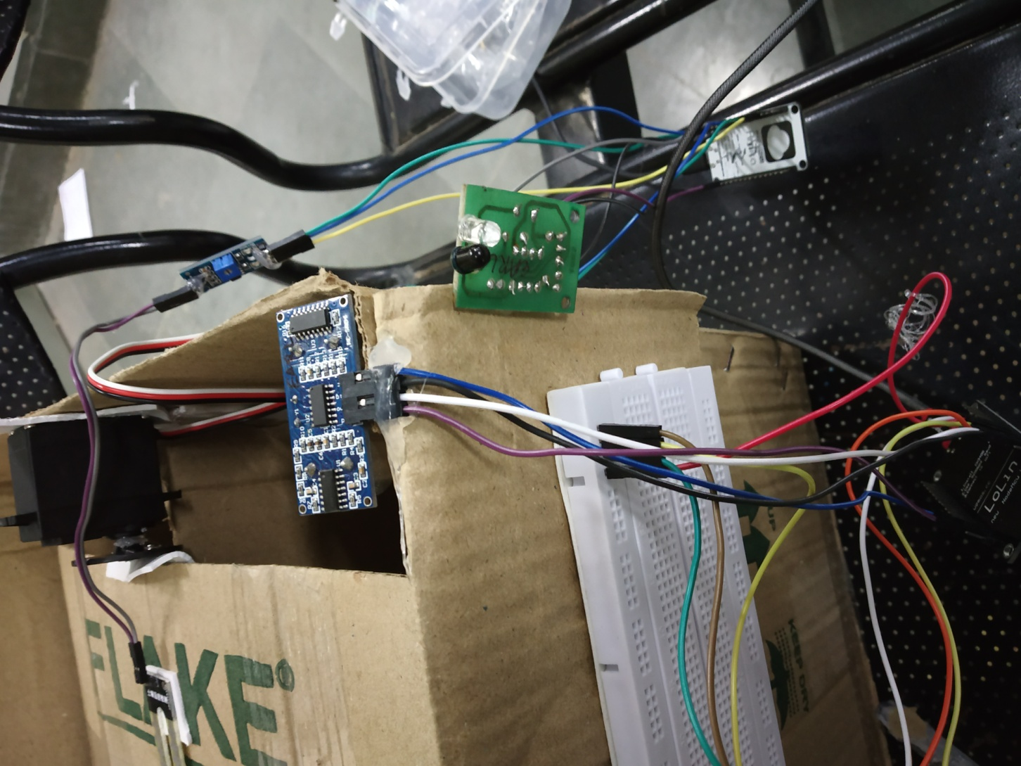
ULTRASONIC AND IR SENSOR

Slide 8
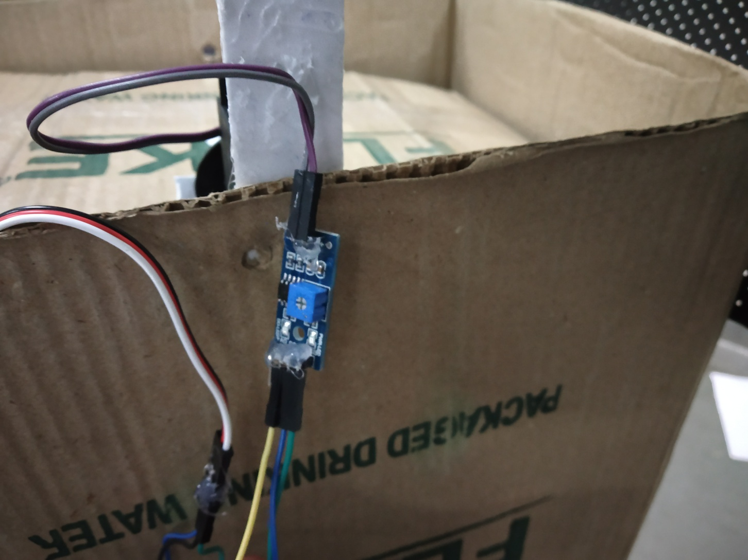
MOISTURE SENSOR INDICATOR

Slide 9
DESCRIPTION
It is smart dustbin used to seperate wet waste and dry waste .Also, it connected to cloud which notifies the authorities (workers) when bin is full.
With this we achieve following things:-
1. Cost effectiveness.
2. Maintains hygiene
3. Decrease human work load
4. Environment friendly
5. Contributes toward smart cities

